Slide 1
EART 28202 : Structural Geology
Class 10 : Strike-slip Tectonic Regimes
Notes:
In the notes panes to these slides there are numerous references (figure credits and further reading). If the reference is incomplete it refers to the references stated in the reading list on the last slide
With regard to figures in this PowerPoint file, many will be subject to copyright restrictions. I don’t care about you using any of the figures/photos that are mine (Steve Covey-Crump), although a credit would be nice, but take care to comply with copyright restrictions if you reuse any that are not

Slide 2
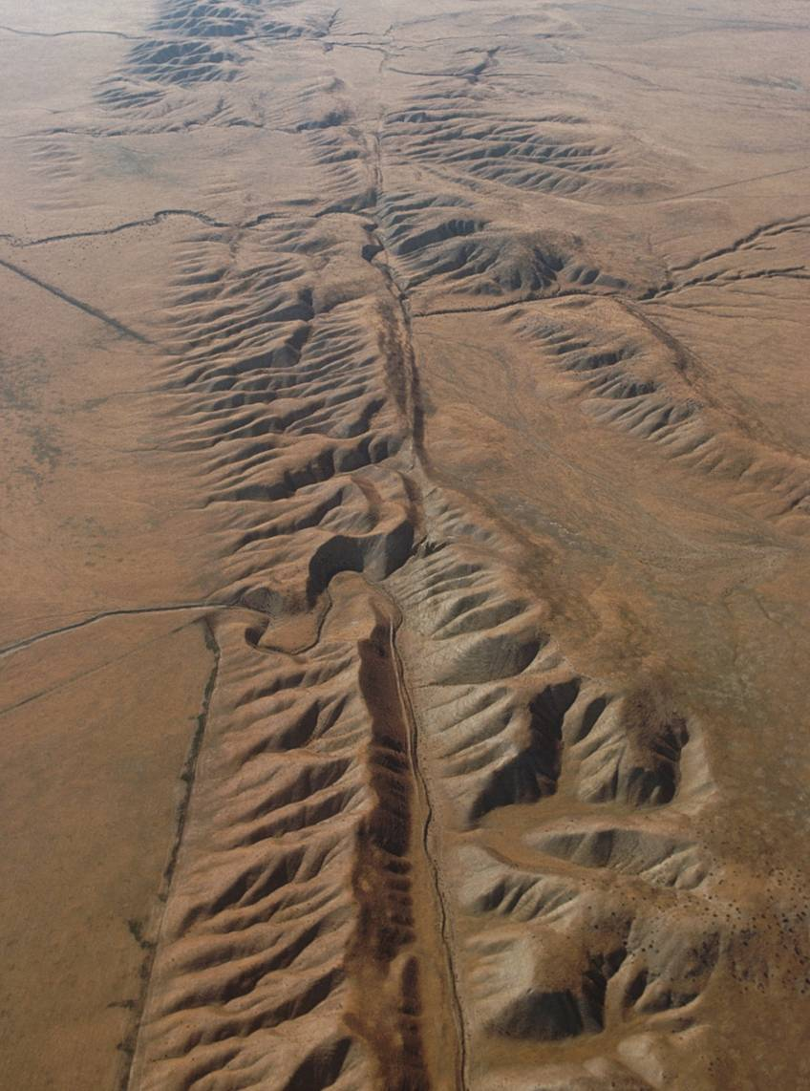
Strike-slip tectonic regimes
Strike-slip faults are faults with a slip vector that is parallel with the strike of the fault, and therefore parallel with the surface of the Earth
They include some of the longest faults in the world and are renown for their close association with major earthquakes – but they occur at all scales
Most large-scale strike-slip faults are approximately vertical and so on maps they appear as straight lines. However, locally they curve and these geometrical irregularities generate a range of structures that are economically significant
San Andreas Fault, California
Notes:
Photo (by George Gerster: www.visualphotos.com/image/1x3747523/san_andreas_fault_san_andreas_fault_aerial): the San Andreas Fault crossing the Carrizo Plain, Central California (looking south). The dextral movement sense is indicated by the change in course of the stream that crosses the fault in the top half of the photo (ends marked by the red stars)

Slide 3
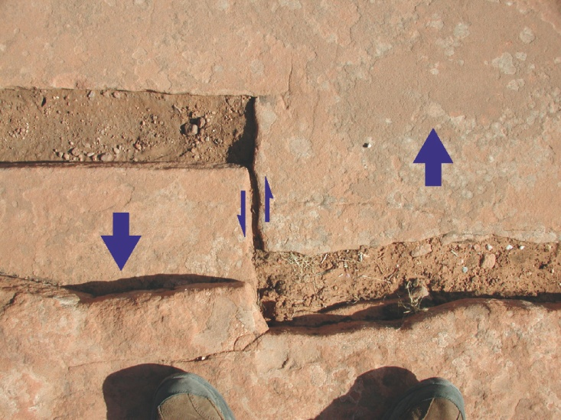
Classification of strike-slip faults
Different names have been applied to strike-slip faults and the way in which these terms are used has not been completely standardized
Wrench fault is an old term that is effectively synonymous with strike-slip fault – it is not now commonly used
Tear faults are relatively small-scale strike-slip faults that accommodate/distribute the slip within larger scale structures; transform faults and transcurrent faults are major regional strike-slip systems
A transfer fault between two extension fractures
A key criterion of distinction is the notion of slip transfer: transfer faults are strike-slip faults with tips that terminate against other faults, and which serve to transfer displacement from one fault to another
Transform faults and some tear faults are transfer faults; transcurrent faults and other tear faults are not
Notes:
Photo (from Fossen, p.403): a transfer fault between two extension fractures on a path, Delicate Arch, Utah. Note that the movement sense indicated by the lazy arrows is opposite to the apparent offset of the extension fractures

Slide 4
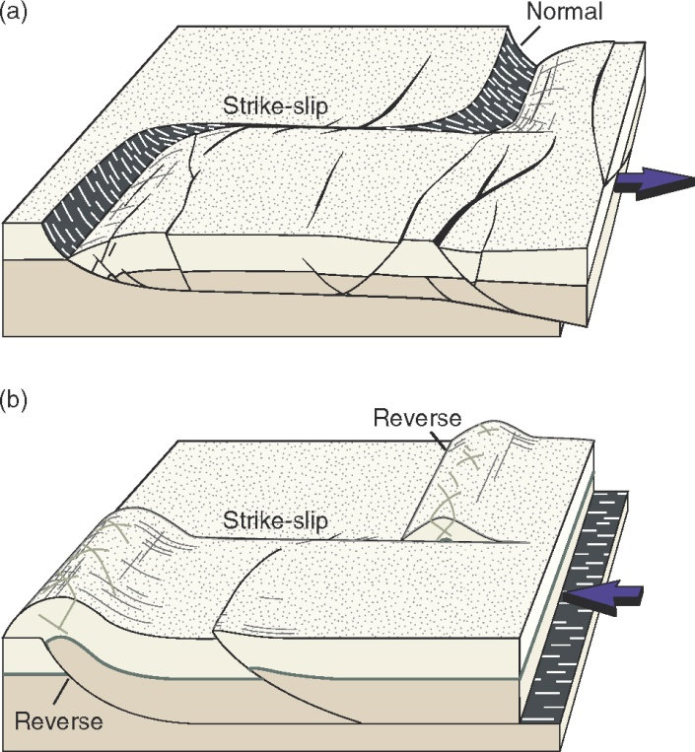
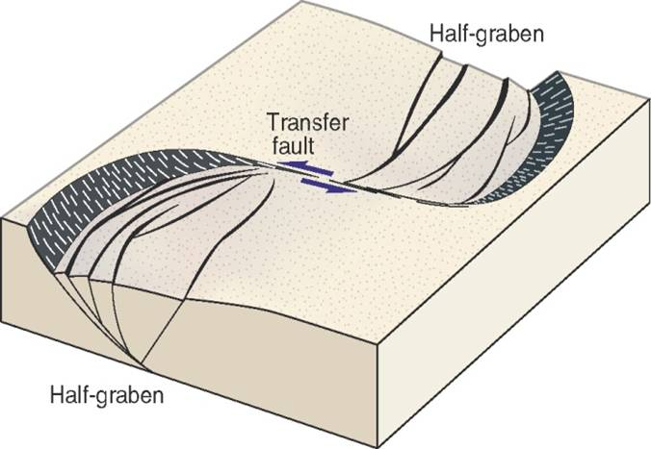
Tear faults that are transfer faults
In contractional and extensional terrains, transfer faults are approximately parallel with the regional transport direction and connect adjacent reverse or normal faults within larger scale contractional or extensional fault systems
They may separate domains in which the extensional/contractional faults have different geometry and displacement (e.g., oppositely dipping rift margin faults)
Tear faults that are transfer faults may reflect the response of the hanging wall to a lateral ramp in the footwall or they may actually be that lateral ramp
Notes:
Figures from Fossen, p.403

Slide 5
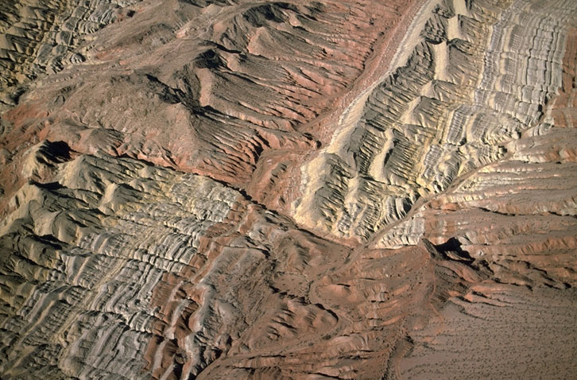
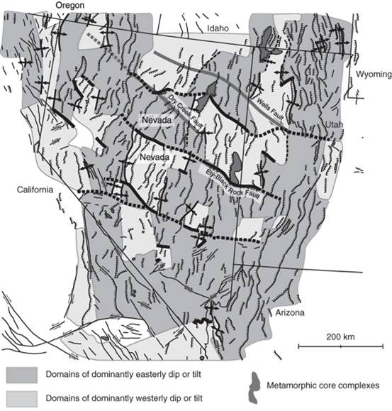
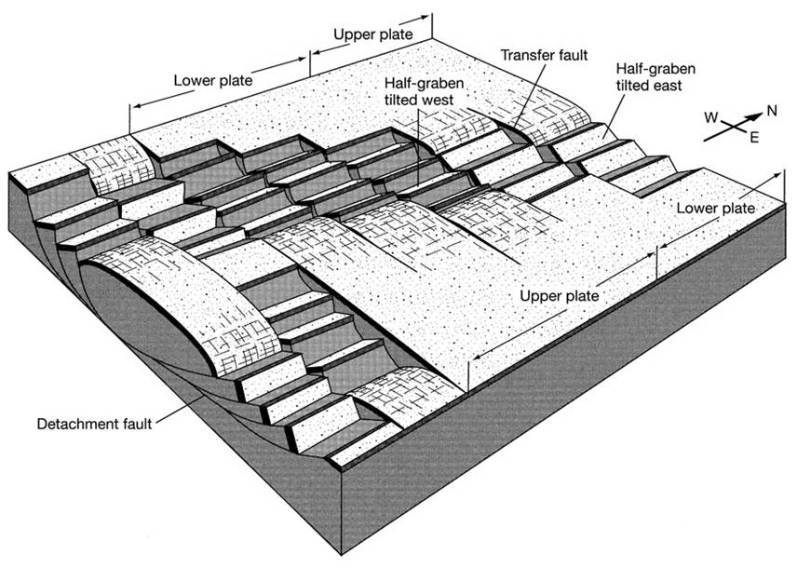
Tear faults that are transfer faults 2
N
Transfer faults (major ones highlighted) within the Basin and Range extensional province
Notes:
Photo (by Marli Miller: http://marlimillerphoto.com/SrF-38.html): a dextral strike-slip fault in southern Nevada. Note that the units in the fault blocks are dipping to the right – they are the tilted hanging walls of listric extensional faults that dip to the left (see Class 9 Slide 31)
Figure bottom left (from Twiss & Moores, p.100): schematic diagram showing the role played by transfer faults (here vertical) in an extensional fault system
Figure top right (from Twiss & Moores, p.101) showing major transfer faults (thicker lines trending approximately east-west) within the Basin and Range extensional province, western U.S.A. The extensional faults within this province are the thinner lines trending approximately north-south

Slide 6
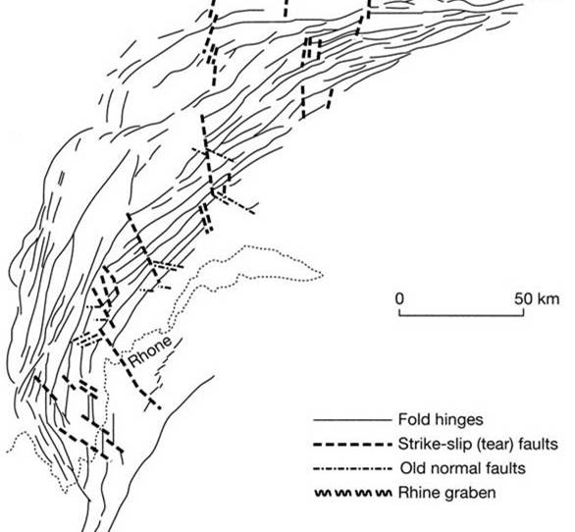
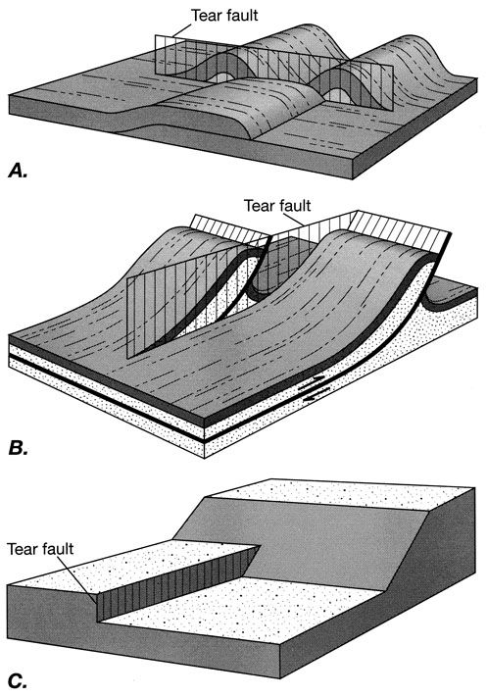
Tear faults that are transfer faults 3
The Jura Mountains (right) are an example of a fold and thrust belt that is segmented by tear faults – these separate sections of the thrust sheet that have different magnitudes of displacement on the underlying décollement
Lake Geneva
In strike-slip terrains second order strike-slip faults may serve to transfer displacement between en échelon first order strike-slip faults. These transfer faults may develop into strike-slip duplexes
Notes:
For second order strike-slip transfer faults, see the New Zealand example on Slide 35
Figure top right (from Twiss & Moores, p.143): tear faults within the Jura Mountains fold and thrust belt, French/Swiss border. Note that many of the fold axial traces (thin solid lines) terminate against the tear faults (thick dashed lines)
Figure top left (from Twiss & Moores, p.124). Note in this illustration how shortening is accommodated by folding on one side of the tear fault, and by thrusting on the other
Figure bottom left (from Twiss & Moores, p.124): two offset thrust sheets connected by a tear fault

Slide 7
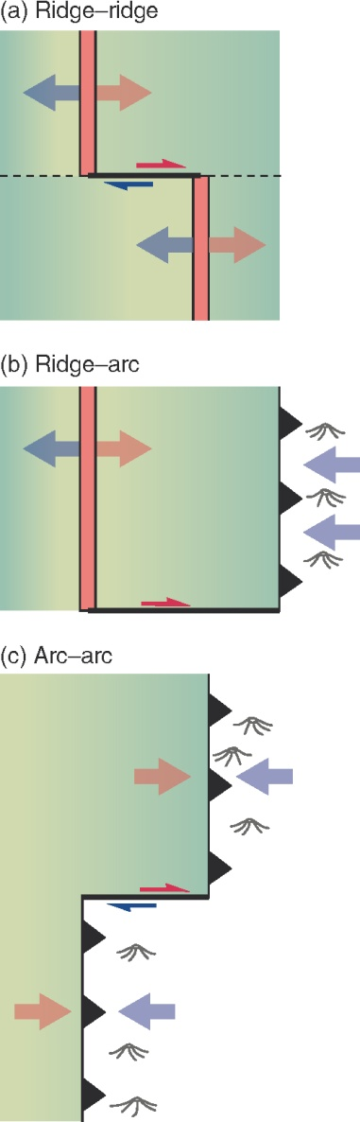
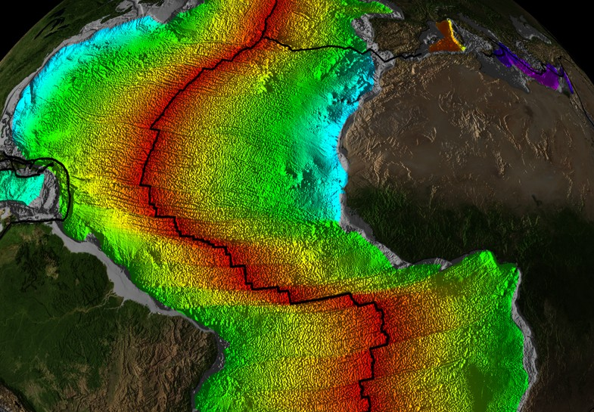
Oceanic transform faults
The largest scale transfer faults are transform faults, the active parts of which form plate boundaries
Oceanic transform faults are of three kinds depending upon the nature of the plate boundaries (ridge or trench) that they connect
Notes:
A transform fault is a strike-slip transfer fault that cuts right through the lithosphere. Transform faults are always parallel with the plate motion direction. The concept of transform faulting as something that makes continuous plate movement possible was first noted by Tuzo Wilson in the 1960s (Wilson, 1965, Nature 207: 343-347, https://doi.org/10.1038/207343a0) and was fundamental for the development of plate tectonic theory
Figure left (from www.ngdc.noaa.gov/mgg/image/crustalimages.html): crustal age map of the ocean floor, Central Atlantic
Figure right from Fossen, p.404

Slide 8
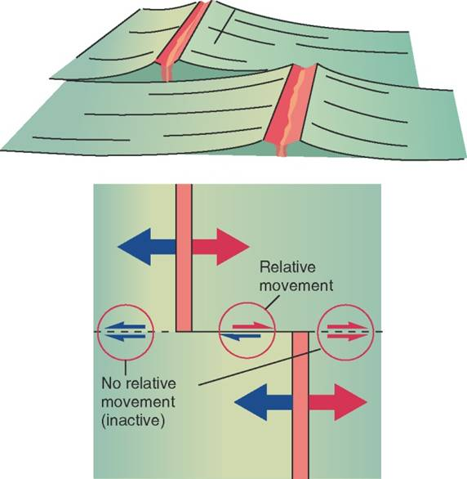
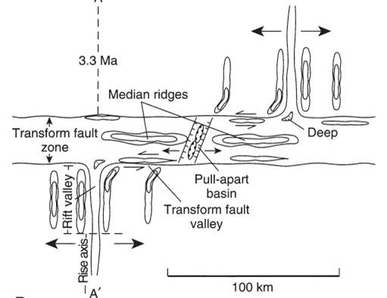
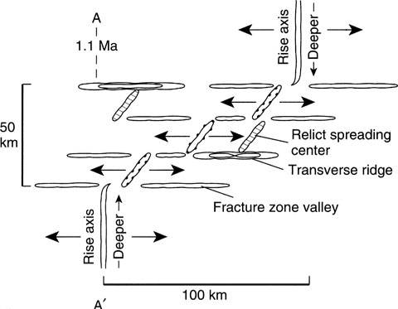
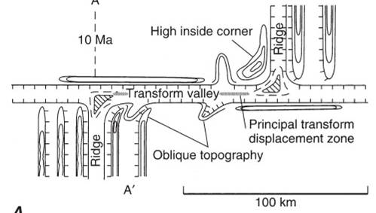
Oceanic transform faults 2
Ridge-ridge transform faults (overwhelmingly the most common kind) comprise active parts between the two ridge segments, and inactive parts – formerly active parts that have passed by the adjacent ridge segment
Note that the slip sense on an active ridge-ridge transform fault is opposite to the apparent offset of the ridges
A ridge-ridge transform fault is not a single plane but a fracture zone many kilometres wide – the width and structural complexity of this zone increases with increasing spreading-rate
intermediate
fast
slow
Notes:
A ridge-ridge transform fault has been exhumed and exposed within the Troodos massif on Cyprus (see MacLeod & Murton, 1993, Geological Society of London, Special Publications 76: 141-176, https://doi.org/10.1144/GSL.SP.1993.076.01.07)
Figure top right from Fossen, p.403
Figures bottom from Twiss & Moores, p.604. Note the various ridges and basins within the fault zone – the origin of these is considered in later slides. A contributing source of the structural complexity in such fault zones is the metamorphism (e.g., serpentinization) that occurs during the deformation

Slide 9
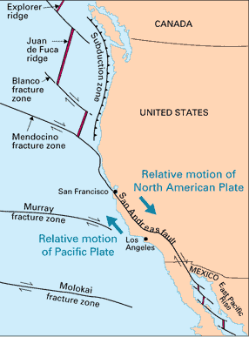
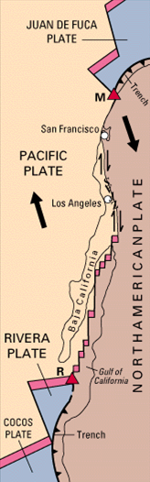
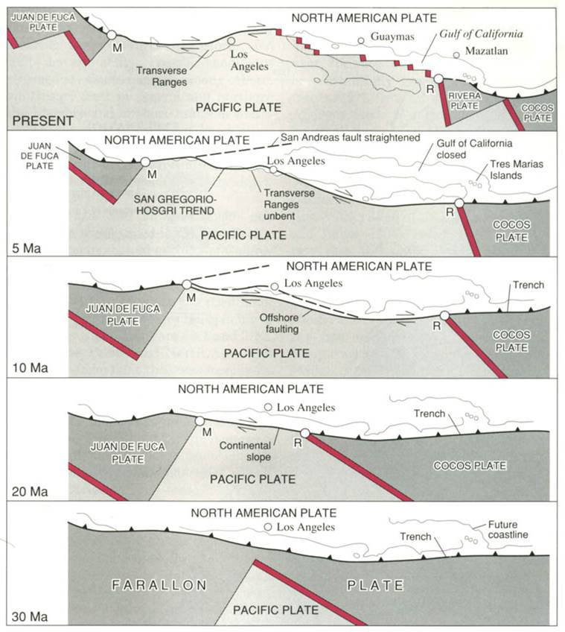
Continental transform faults
Transform faults occur on the continents as well as in the ocean
The 1200 km long and 100-150 km wide San Andreas Fault Zone is a particularly well studied example
600-1000 km strike-slip displacement
Notes:
For a major review of the features of continental transform faults, see Şengör et al., 2019, in: Duarte JC (editor), Transform Plate Boundaries and Fracture Zones, p.169-247, https://doi.org/10.1016/B978-0-12-812064-4.00009-8. This review describes features that would undoubtedly be of interest when considering strike-slip faulting on other planetary bodies
The San Andreas-Gulf of California system connects two plate triple junctions, one south of the Gulf of California at Rivera (R on the middle map) and the other on the north coast of California at Cape Mendocino (M on the middle map). It comprises two parts: (1) the San Andreas strike-slip fault zone, and (2) a set of transform faults/short ridge segments in the Gulf of California (transtension). Estimates of the total strike-slip displacement on this system range from 600 to 1000 km. Currently, the San Andreas Fault Observatory at Depth (SAFOD) programme is drilling deep into the fault zone to make geophysical measurements and to recover rock and fluid samples (http://earthquake.usgs.gov/research/parkfield/safod_pbo.php)
Map left from http://geomaps.wr.usgs.gov/archive/socal/geology/geologic_history/san_andreas_history.html
Map middle from http://pubs.usgs.gov/gip/dynamic/Farallon.html
Map right (from http://en.wikipedia.org/wiki/File:San_Andreas_Fault_Sequential_Diagrams.jpg): the evolving plate boundary configuration along the western coast of North America during the last 30 million years. Tanya Atwater’s movie, California_20my.mp4, accompanying this presentation shows an animation of this evolution. Also accompanying this presentation are two other Atwater animations, California_38my_Past.mp4 and California_10my_Future.mp4. The first shows the plate tectonic evolution of western U.S.A. over the last 38 myr, and second the projected evolution of this region over the next 10 myr. If you like her animations, see many more on a variety of themes at https://animations.geol.ucsb.edu/1_DownloadPage/Download_Page.html#SoCal. For a review of the evolution of the San Andreas Fault system and the current state of attempts to use a tectonic understanding of the fault system to consider earthquake hazards, see Scharer & Streig, 2019, in: Duarte JC (editor), Transform Plate Boundaries and Fracture Zones, p.249-269, https://doi.org/10.1016/B978-0-12-812064-4.00010-4
Note that the plate boundary along the California coast changed from being a subduction zone (see 30 Ma map) to a transform fault (all other maps). It is thought that water derived from dehydration of the mantle wedge above the relict subducted slab as it warmed up, migrated upwards into the crust and, by raising pore fluid pressures there, facilitated slip on the faults within the San Andreas system (see Kirby et al., 2014, Earth, Planets and Space 66, article 67, https://doi.org/10.1186/1880-5981-66-67). This helps to explain why the Californian continental margin is so weak, and hence why the San Andreas fault system became established there. It also helps to explain why the plate boundary is a broad system of faults (the water was released over a wide area), and why fault-bound and diapiric serpentinite bodies occur within the Californian coastal ranges (water release from deeper in the mantle wedge helped to mobilize serpentinite bodies that originally were contained within the mantle wedge above the dehydration front)

Slide 10
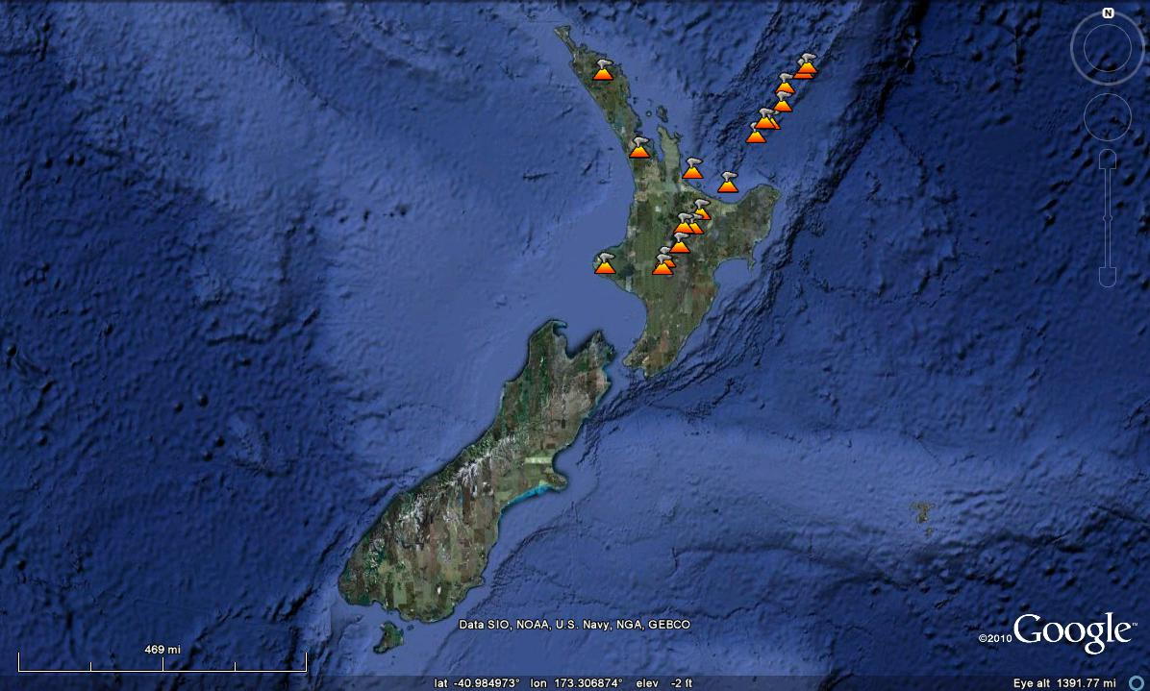
Continental transform faults 2
Another example is the Alpine Fault in New Zealand, which forms a predominantly strike-slip portion of the boundary between the Australian and Pacific plates – in the north the Pacific plate is being subducted under the Australian plate, but in the south it is the other way around; the Alpine Fault is a transfer fault between these two subduction zones
Kermadec trench
Australian plate
North Island fault system
5.4 cm/yr
Hikurangi Trough
Pacific plate
Alpine fault
Marlborough fault system
Puysegur
trench
3.1 cm/yr
Notes:
Map from a PowerPoint presentation by Michael Bunds and Laura Benninger: http://research.uvu.edu/bunds.christchurch.earthquake.web.pps

Slide 11
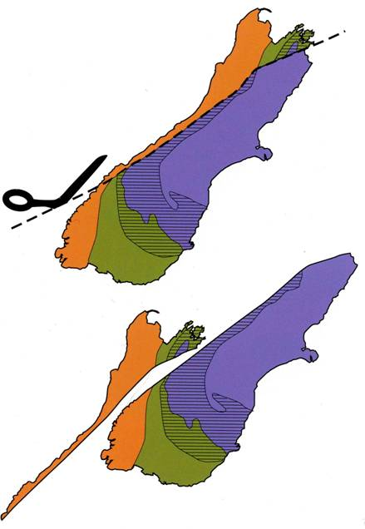
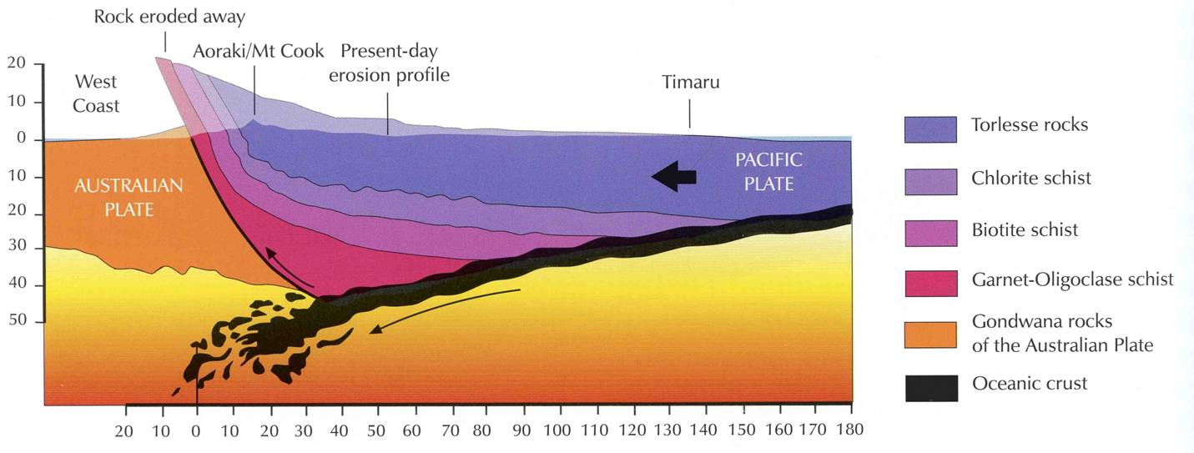
Continental transform faults 3
The Alpine Fault actually has a significant degree of compression acting across it, that is, it is a transpressive strike-slip fault. Hence in addition to 480 km of dextral strike-slip motion over the past 25 myr, there has also been ~20 km of uplift
Seismic data indicate that the fault is not vertical but listric, and that it extends to a depth of at least 30 km
Note that by definition (as plate boundaries), transform faults must cut right through the lithosphere
Notes:
Current rates of movement on the Alpine Fault are ~20-30 mm/yr strike-slip and locally up to 10 mm/yr uplift (for an examination of slip-rates on the Alpine fault, see Barth et al., 2014, Journal of Structural Geology 64: 39-52, https://doi.org/10.1016/j.jsg.2013.08.009). It is estimated that about half a million cubic kilometres of rock have been eroded during this uplift, making New Zealand a fantastic place for sedimentologists and geomorphologists
Figure top right (from Coates, 2002, The Rise and Fall of the Southern Alps, Canterbury University Press, p.39) showing the strike slip offset on the Alpine Fault as made evident by the offset of metamorphic zones
Figure bottom (from Coates, 2002, The Rise and Fall of the Southern Alps, Canterbury University Press, p.52) showing the dip-slip offset on the Alpine Fault and the shape of the fault at depth. The numbers on the cross-section are in kilometres

Slide 12
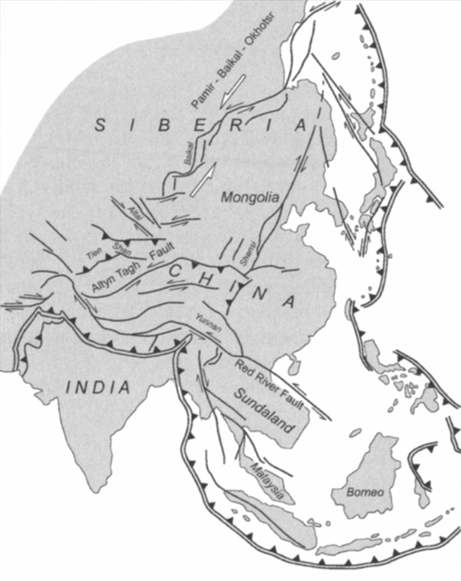
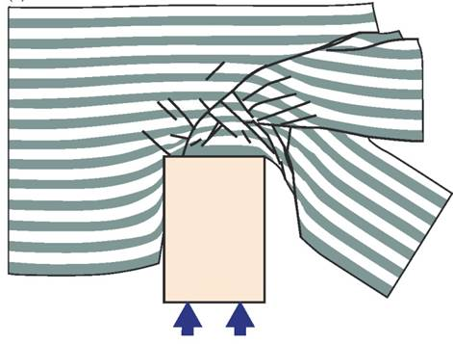
Transcurrent faults
Transcurrent faults are not transfer faults but rather they have free tips and so increase in length as the displacement accumulates
Such intraplate faults can be 1000s km long and can accommodate 100s km displacement
Prime examples come from East-Central Asia where there is a complex array of conjugate transcurrent faults – dominantly sinistral in eastern Tibet, and dominantly dextral in an area extending from Lake Baikal to Afghanistan and Pakistan in the west
This array has been attributed to the indentation and sideways extrusion of Asia in response to the collision of India with Eurasia that has been ongoing throughout the Cenozoic
Notes:
For a summary of the key features of transcurrent faults, see Storti et al., 2003, Geological Society of London, Special Publication 210: 1-14, https://doi.org/10.1144/GSL.SP.2003.210.01.01
Figure top right from Storti et al., 2003, Geological Society of London, Special Publication 210: 1-14, https://doi.org/10.1144/GSL.SP.2003.210.01.01
Figure bottom right (from Fossen, p.408) showing the results of a physical model in which India is treated as a stiff indenter into a relatively weak Eurasia (see Tapponnier et al., 1986, Geological Society of London, Special Publication 19: 113-157, https://doi.org/10.1144/GSL.SP.1986.019.01.07)

Slide 13
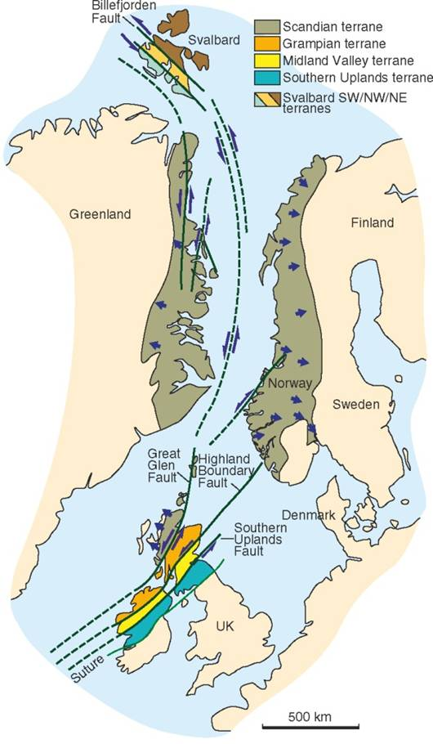
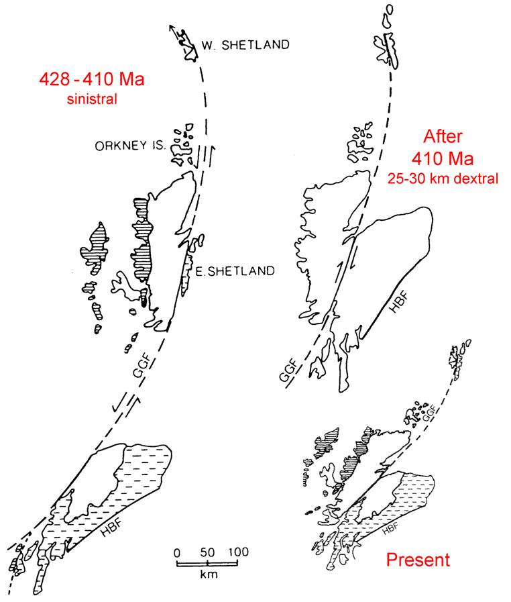
Transcurrent faults 2
Another example is the Great Glen Fault – one of several major strike-slip faults within the Caledonian orogenic belt that were active during the oblique convergence of Baltica and Laurentia (428 - 410 Ma)
Notes:
Figure right (from Fossen, p.407): on this figure Baltica is Denmark/Sweden/Finland; Laurentia is Greenland. For details of the sinistral transpression that accompanied the final closure of the Iapetus Ocean, see Soper et al., 1992, Journal of the Geological Society, London 149: 871-880, https://doi.org/10.1144/gsjgs.149.6.0871
Figure bottom left (adapted by Steve Covey-Crump from Storetvedt, 1987, Tectonophysics 143: 253-267, https://doi.org/10.1016/0040-1951(87)90213-7): reconstruction of the strike-slip displacement on the Great Glen Fault. The magnitude of sinistral strike-slip movement on the Great Glen Fault during the convergence of Baltica and Laurentia is presently estimated at ~900 km (Dewey & Strachan, 2003, Journal of the Geological Society, London 160: 219-229, https://doi.org/10.1144/0016-764902-085). In common with many major crustal lineaments, the Great Glen Fault has had an extended history of reactivation, in this case, primarily during the Variscan orogeny and during the Cenozoic. The total slip during these times of reactivation amounts to 25-30 km of dextral offset (Rogers et al., 1989, Journal of the Geological Society, London 146: 369-372, https://doi.org/10.1144/gsjgs.146.3.0369; Le Breton et al., 2013, Journal of the Geological Society, London 170: 403-415, https://doi.org/10.1144/jgs2012-067)

Slide 14
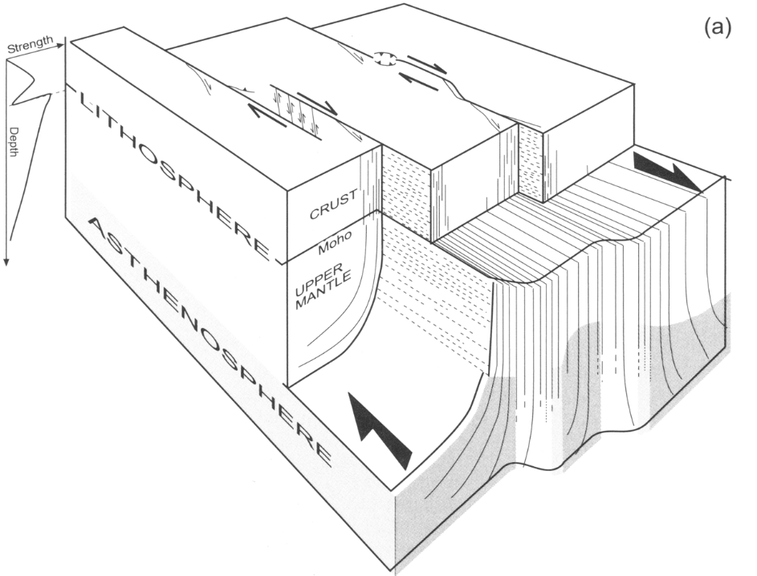
Transcurrent faults 3
There is some ambiguity about what happens to transcurrent faults at depth. However, it is likely that any that are
subvertical
over 300 km long, and
have an offset of over 30 km
cut right through the lithosphere
Post-orogenic lamprophyre dykes a few km NW of the Great Glen Fault were derived from different source rocks compared with those intruded a few km SE of the fault. Since the lamprophyre magmas were generated at depths of over 100 km, this implies that the Great Glen Fault is vertical and extends to at least these depths
Notes:
The lamprophyre dykes of north-western Scotland were emplaced at 400±10 Ma, after the Caledonian orogeny. Those north-west of the Great Glen Fault are relatively enriched in light rare earth elements and large ion lithophile elements (notably Ba, Sr and P) compared with those south of the fault, and they have completely different neodymium compositions. These differences require that the source rock (lithospheric mantle) of the lamprophyre magmas north of the Great Glen Fault had previously experienced a series of metasomatic events that the source rock of the lamprophyre magmas south of the Great Glen Fault had not. The mica and clinopyroxene phenocrysts found in the more mafic lamprophyre varieties could only have been in magmatic equilibrium at pressures of 20 kbar (2000 MPa) and temperatures of 1000°-1200°C, which equates to a depth of ~60 km. Consideration of the rare earth element chemistry and the K and Rb composition of the lamprophyres, and what this implies about the residual phases left in the source region when the magmas were formed, extends the estimated depth of formation to over 100 km. Hence the Great Glen Fault must transect the whole Caledonian lithosphere. For details, see Canning et al., 1998, Journal of the Geological Society, London 155: 425-428, https://doi.org/10.1144/gsjgs.155.3.0425
Figure from Storti et al., 2003, Geological Society of London, Special Publication 210: 1-14, https://doi.org/10.1144/GSL.SP.2003.210.01.01

Slide 15
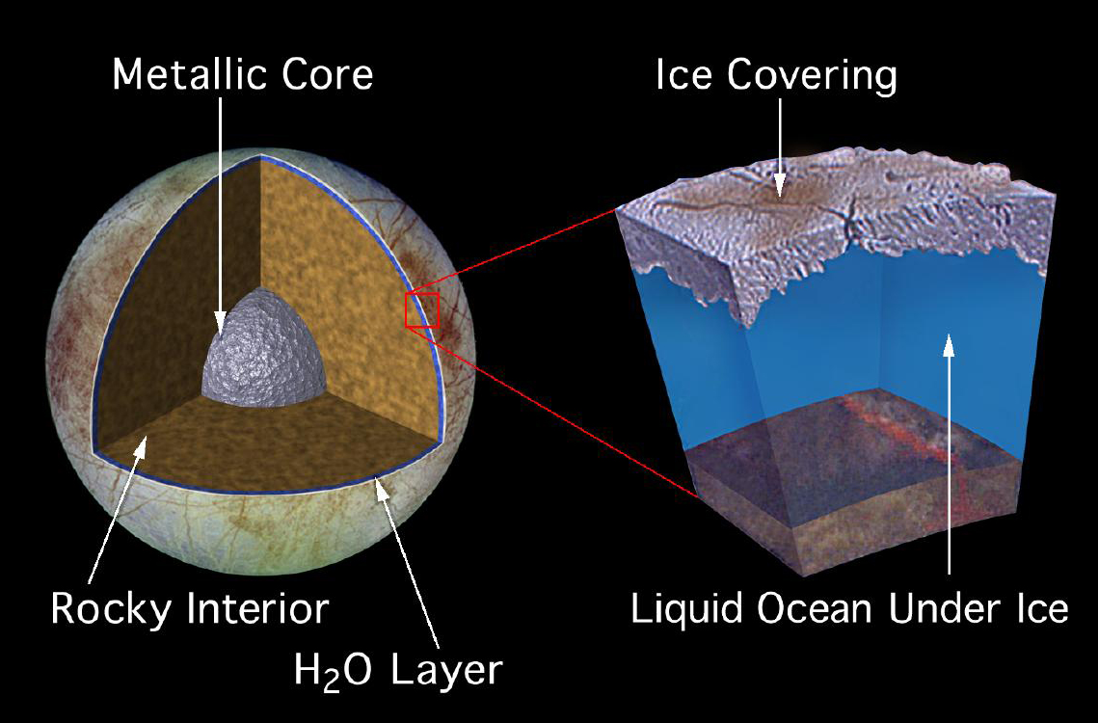
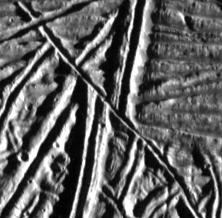
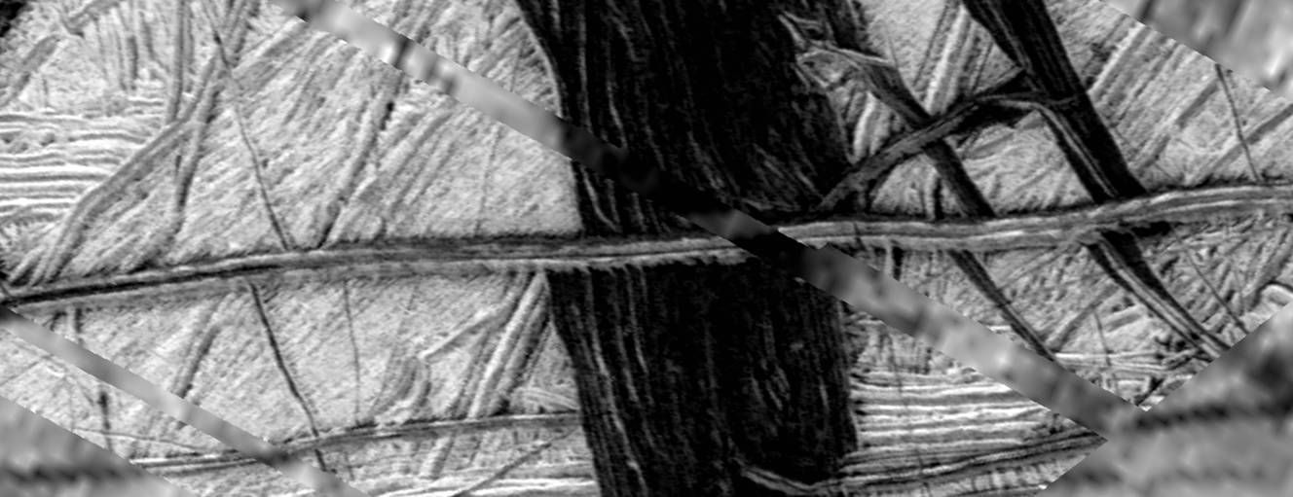
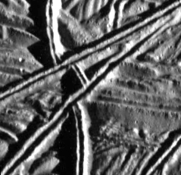
Strike-slip faults on other planetary bodies
Strike-slip faults have been recognized on Mercury, Venus, and Mars, and on several outer Solar System satellites, most notably on Jupiter’s moon, Europa
Europa’s thin ice crust is subjected to strong tidal forces arising from its orbital eccentricity and axis obliquity → strike-slip shear zones include Agenor Linea, a dextral strike-slip shear zone that is 1500 km long, 20-30 km wide
5 km
Notes:
The complex time-varying nature of the stresses exerted on the crust of Europa as it orbits Jupiter has produced a wide range of contractional and extensional faults as well as the strike-slip faults. On the tectonics of Europa (including arguments for “subduction”), see Kattenhorn & Prockter, 2014, Nature Geoscience 7: 762-767, https://doi.org/10.1038/ngeo2245. For strike-slip deformation on Europa, see Hoppa et al., 1999, Icarus 141: 287-298, https://doi.org/10.1006/icar.1999.6185; Prockter et al., 2000, Journal of Geophysical Research 105: 9483-9488, https://doi.org/10.1029/1999JE001226; Rhoden et al., 2012, Icarus 218: 297-307, https://doi.org/10.1016/j.icarus.2011.12.015. For information on Agenor Linea, see Hoyer et al., 2014, Icarus 232: 60-80, https://doi.org/10.1016/j.icarus.2013.12.010
For strike-slip deformation features on other planets: Mercury (Massironi et al., 2015, Geological Society, London, Special Publications 401: 269-290, https://doi.org/10.1144/SP401.16), Venus (Koenig & Aydin, 1998, Geology 26: 551-554, https://doi.org/10.1130/0091-7613(1998)026<0551:EFLSSS>2.3.CO;2; Byrne et al., 2017, 48th Lunar and Planetary Science Conference abstract 2708, https://www.hou.usra.edu/meetings/lpsc2017/pdf/2708.pdf), and Mars (Hanna et al., 2008, Journal of Geophysical Research 113, article E08002, https://doi.org/10.1029/2007JE002980; note also the analysis of Valles Marineris (see Class 9 Slide 13) as a transtensional strike-slip fault with ~160 km sinistral strike-slip displacement – Yin, 2012, Lithosphere 4: 286-330, https://doi.org/10.1130/L192.1)
For strike-slip deformation features on the icy satellites of the outer Solar System (other than Europa): Ganymede (Pappalardo et al., 1998, Icarus 135: 276-302, https://doi.org/10.1006/icar.1998.5966); Enceladus (Martin, 2016, Geophysical Research Letters 43: 2456-2464, https://doi.org/10.1002/2016GL067805); Triton (Croft et al., in: Cruikshank (editor), 1995, Neptune and Triton, University of Arizona Press, p.879-947)
Figure top left is from http://www.explanet.info/Chapter09.htm#The_Galilean_Satellite
Image bottom left (extracted by Steve Covey-Crump from http://simkin.asu.edu/galileo/, Galileo Orbit E12 Mosaic E12ESWEDGE_01602_cxt) showing a strike slip fault that clearly offsets four markers (on the fault at locations above the red arrows), including the wide extensional band, Yelland Linea (the thick dark band running top to bottom in the centre of the image), in Argadnel Regio, Europa. This fault is discussed by Schultz et al., 2010, Journal of Structural Geology 32: 855-875, https://doi.org/10.1016/j.jsg.2009.09.005
Images top right and bottom right (extracted by Steve Covey-Crump from http://simkin.asu.edu/galileo/, Galileo Orbit E6 Mosaic E6ESBRTPLN02) showing examples of strike-slip faults from the Bright Plains region of Europa (near Androgeos Linea in the Conamara Chaos region). Each image is about 2 km across

Slide 16
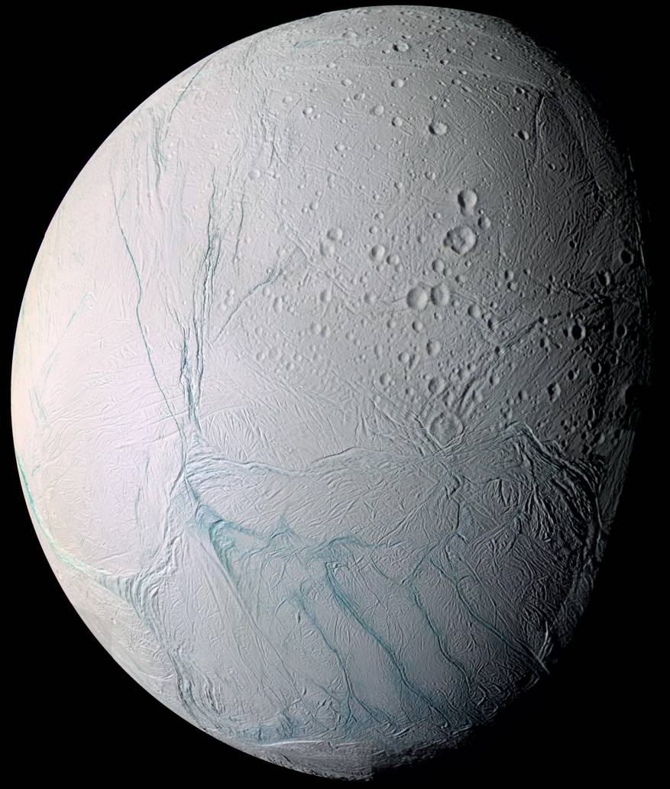
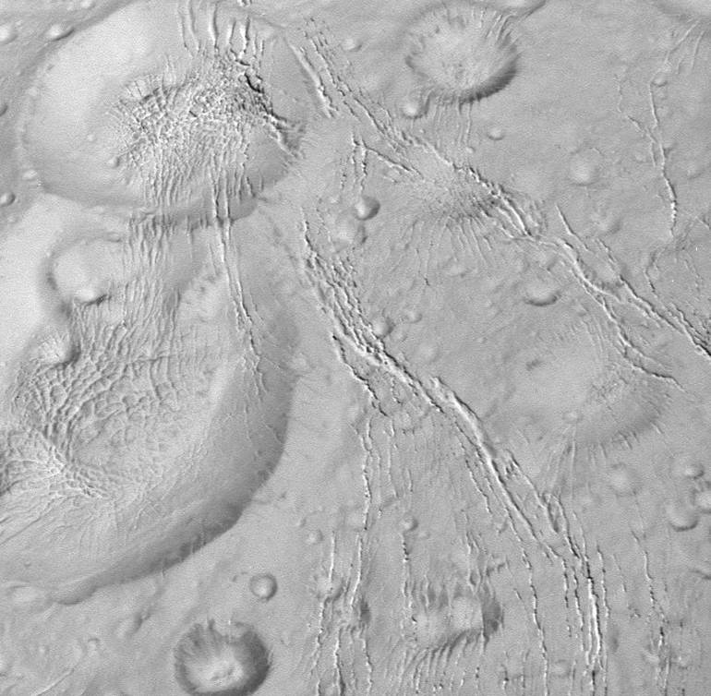


Strike-slip faults on other planetary bodies 2
In the southern polar region of Enceladus, water vapour curtain geysers are continuously erupting from sinistral strike-slip faults
Elsewhere on Enceladus, the strike-slip nature of the faults must be inferred from secondary structures (no offset markers)
10 km
Notes:
Enceladus is one of the moons of Saturn. It is 500 km in diameter and has an icy crust. The moon has a slight wobble as it orbits Saturn implying that, like Europa, there is a global ocean under the crust. In the south polar region, the tidal stresses induced by the non-synchronous rotation of this ocean and the crust have generated a complex and evolving fracture network. Four particularly prominent subparallel fractures, each ~130 km long, 2 km wide and 500 m deep, are informally known as the “tiger stripes”, and are sinistral strike-slip faults along which curtain geyser eruptions are continuously occurring. For the discovery of the tiger stripes, see Porco et al., 2006, Science 311: 1393-1401, https://doi.org/10.1126/science.1123013. For the evolution of this fracture network, see Yin & Pappalardo, 2015, Icarus 260: 409-439, https://doi.org/10.1016/j.icarus.2015.07.017. For an attempt at using the geometry of this fracture network, and in particular the regular spacing (~35 km) of the four tiger stripes, to infer the thickness of the icy crust of Enceladus, see Yin et al., 2016, Icarus 266: 204-216, https://doi.org/10.1016/j.icarus.2015.10.027 (although much of this paper is rather advanced for 2nd year level). Note also that the spatial distribution of fractures and their length may also be used to infer lithospheric thickness – for application to Enceladus, see Lucchetti et al., 2017, Icarus 297: 252-264, https://doi.org/10.1016/j.icarus.2017.07.009
Faulting on Enceladus outside the south polar region has received much less attention. For a survey of these faults, see Martin, 2016, Geophysical Research Letters 43: 2456-2464, https://doi.org/10.1002/2016GL067805. The origin of these faults is not easily attributable to tidal stresses generated by non-synchronous rotation and is a matter of ongoing research. Note that the lack of offset markers on these faults means that to demonstrate that there is a strike-slip component to the slip vector, attention needs to be paid to secondary fractures associated with the faults (hence the rest of this presentation!)
Image right (from http://photojournal.jpl.nasa.gov/catalog/PIA06254): composite image of Enceladus taken by Cassini-Huygens. The four sub-parallel fractures highlighted in darker blue at the bottom of the image are the “tiger stripes”
Inset image bottom centre (from http://photojournal.jpl.nasa.gov/catalog/PIA14658): the plume of vapour ejecting from the fractures in the south polar region (north is up and rotated 45° to the right)
Inset image bottom centre (from NASA, 2017, The Saturn System through the eyes of Cassini, available as a free download from www.nasa.gov/ebooks): another Cassini view of the vapour plumes being erupted from the ‘tiger stripe’ faults. The publication that this image came from has a number of images of fracture systems on Enceladus, including a high-resolution image of one of the tiger-stripe faults (p.74)
Image bottom left (from http://photojournal.jpl.nasa.gov/catalog/PIA20011, with lazy arrows added by Steve Covey-Crump): fractures in a region near to the north pole of Enceladus. The two big craters on the left side of the image are Dunyazad (bottom, 31 km diameter) and Shahrazad (top, 20 km diameter). The slip sense on the top fracture system is inferred by the orientation of the en échelon fractures (which are in Riedel shear (R) orientation, see photo right on Slide 20 for the geometry) – the rather small angle between the en échelon fractures and the shear zone boundaries suggests that the shear zone is transtensional (see Class 4 Slide 36); the slip sense on the lower fracture system is inferred from the imbricate fan of normal faults (horsetail cracks) at each end of the fault (see figure bottom left on Slide 33 for the geometry)

Slide 17
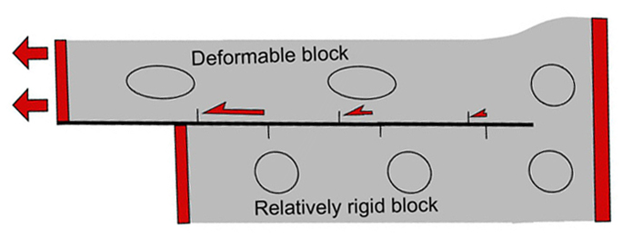
Stretching faults
We tend to think of the two blocks on either side of a fault as being approximately rigid, but when one side is more deformable than the other, the fault marks the boundary between relatively strongly deformed units and relatively undeformed units, and we then have a stretching fault → slip-parallel stretching of one side of the fault when compared with the other
On a stretching fault the slip is zero at the fault tip and varies along the fault
This style of deformation may occur on any fault, but it is particularly noteworthy on major strike-slip faults where the slip can vary by up to tens of kilometres along the fault
Notes:
The concept of stretching faults was introduced by Win Means (Means, 1989, Geology 17: 893-896, https://doi.org/10.1130/0091-7613(1989)017<0893:SF>2.3.CO;2; Means, 1990, Journal of Structural Geology 12: 267-272, https://doi.org/10.1016/0191-8141(90)90010-V). They are effectively surfaces across which there is a displacement velocity discontinuity. For a stretching fault, fault slip and the deformation of the “blocks” either side of the fault are geometrically independent, albeit driven by the same remote loads. Hence recognizing a fault as a stretching fault has significant implications for understanding the development of fabrics and minor structures associated with the fault, e.g., the stretching component may lead to a fault-parallel cleavage (extensional parallel to the fault) or a fault-normal cleavage (contractional parallel to the fault) associated with the deformation of the blocks either side of the fault, instead of/in addition to the fabrics described in the rest of this presentation which are produced by the slip. It also has implications for attempts to model the deformation
For further discussion, illustrated with examples of strike-slip stretching faults, see Rutter & Valetti, 2019, in: Duarte JC (editor), Transform Plate Boundaries and Fracture Zones, p.301-320, https://doi.org/10.1016/B978-0-12-812064-4.00012-8
Figure from Rutter et al., 2012, Journal of Structural Geology 45: 68-86, https://doi.org/10.1016/j.jsg.2012.08.009

Slide 18
Structures associated with strike-slip faults

Slide 19
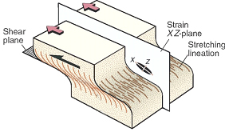
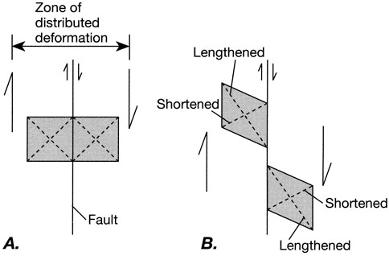
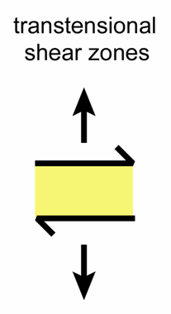
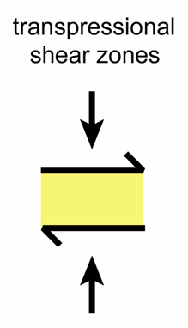
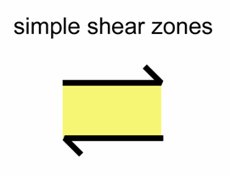
Simple shear/transpression/transtension
For a sub-vertical strike-slip fault deforming in simple shear the map is approximately the XZ plane across a shear zone. Hence many of the features observed in strike-slip fault zones can be considered (at least, kinematically) by thinking about the structures we noted when examining shear zones (Class 4)
In doing so, it is helpful to remember the orientation of the directions that are shortened and those that are extended during progressive simple shear (Class 3)
But note – real strike-slip faults may involve a combination of simple shear and fault normal shortening (transpression) or fault normal extension (transtension)
Notes:
Recall that X is the long axis of the strain ellipsoid and Z is the short axis of the strain ellipsoid, that is, X is the direction of greatest extension and Z is the direction of greatest shortening (see Slide 37 or Class 3 Slide 15). For the orientation of X and Z across a shear zone, see Class 4 Slide 12. On shortening and extension directions during progressive simple shear, see Class 3 Slides 21-23
To the transpression and transtension variants (contraction or extension normal to the fault) we may also add the case where the rocks on either side of the fault deform by different amounts, that is, the stretching fault variant (extension or contraction component parallel to the fault, see Slide 17)
Figure top right from Fossen, p.342
Figure bottom left from Twiss & Moores, p.148
Figures bottom right by Steve Covey-Crump

Slide 20
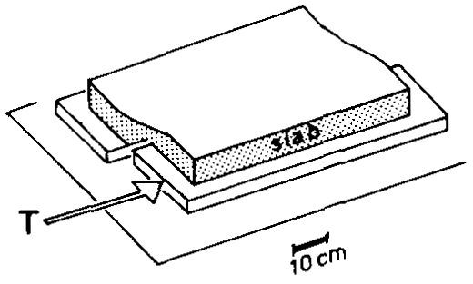
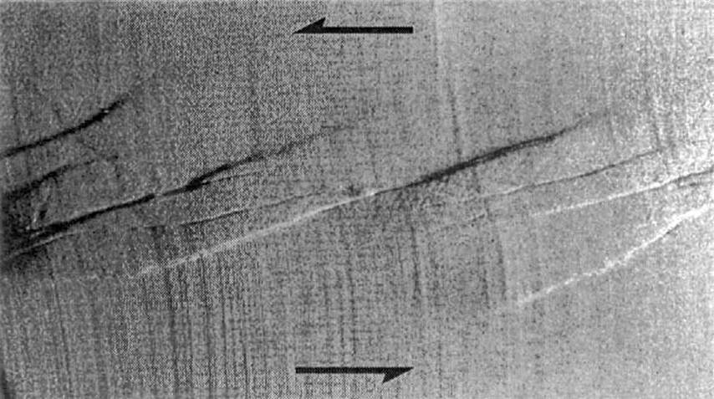
Analogue modelling
Experiments performed on analogue materials have been tremendously helpful for establishing the evolution of structures within strike-slip fault zones and for refining our kinematic intuitions
The classical experiments are those of Riedel in 1929 who set up two rigid rectangular blocks to represent basement, with a thick tablet of clay on top to represent the cover. By moving the blocks in a strike-slip sense, the traction at the interface between basement and cover produces stresses in the cover and hence it deforms
This simple experimental set up has been developed to incorporate non-planar faults and materials with different properties (including sands instead of clay), but the essential principles of the experiment remain the same
Notes:
For a review of analogue models used to explore the evolution of structures within strike-slip fault zones, see Dooley & Schreurs, 2012, Tectonophysics 574-575: 1-71, https://doi.org/10.1016/j.tecto.2012.05.030
Figure top right (from Tchalenko, 1970, Geological Society of America Bulletin 81: 1625-1640, https://doi.org/10.1130/0016-7606(1970)81[1625:SBSZOD]2.0.CO;2) showing the set up of a Riedel experiment
Figure bottom right (from Richard et al., 1995, Petroleum Geoscience 1: 71-80, https://doi.org/10.1144/petgeo.1.1.71) showing a plan view of the results of a Riedel experiment in which a thick layer of dry sand was used for the cover instead of clay. The shear offset is apparent from the deflection of the lines running top to bottom in the image. Note the prominent fracture set formed oblique to the shear zone boundaries. These are Riedel shears (see next slide)

Slide 21
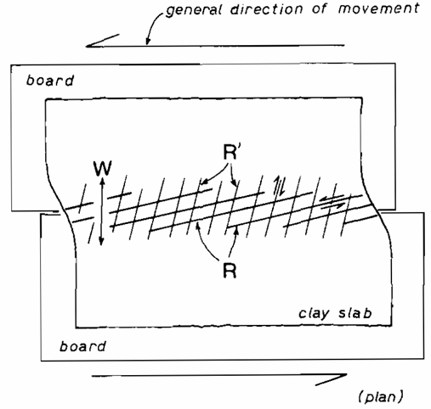
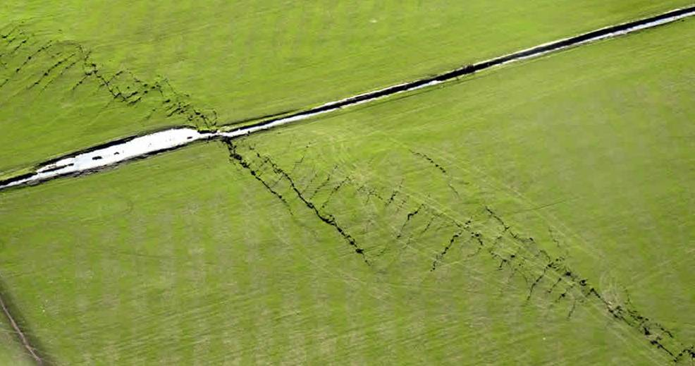
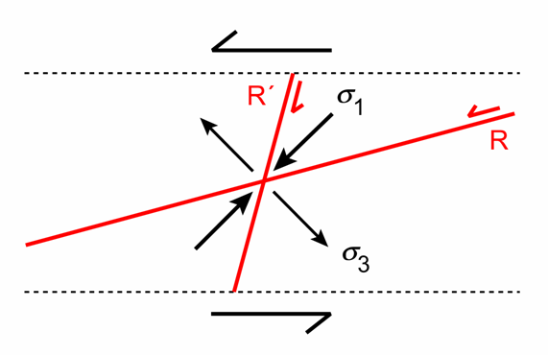
Associated fractures
Riedel found that two sets of shear fractures (R and R´) develop oblique to the fault margins. These are now known as Riedel shears and may be rationalized as a conjugate fracture set about the direction of the maximum compressive principal stress
Of these two sets, the R-shears are the ones that develop more frequently
R
R´
Riedel shears developed in a field (soil over bedrock) during the Christchurch earthquake, 4 Sept 2010; dextral offset shown by irrigation ditch and Riedel shears
Notes:
Figure top left from Tchalenko, 1970, Geological Society of America Bulletin 81: 1625-1640, https://doi.org/10.1130/0016-7606(1970)81[1625:SBSZOD]2.0.CO;2
Figure bottom left by Steve Covey-Crump. Recall that in a simple shear zone σ₁ is at 45° to the shear zone boundary. Faults form at ~30° to σ₁ (see Class 7 Slide 22). Hence in an ideal simple shear zone, the R-shears are at 15° to the shear zone boundary and the R´ shears are at 75°. In transpressional or transtensional shear zones these angles are modified by the amount of shortening/extension normal to the fault boundary that is simultaneously applied (see Class 4 Slide 36)
Photo right (cover photo for the May 2011 issue of Quarterly Journal of Engineering Geology and Hydrology) showing the development of Riedel shears in soils above the Greendale Fault at Darfield, about 40 km west of Christchurch, New Zealand. This photo was taken on 4 September 2010 about 12 hours after a magnitude 7.1 earthquake had occurred on the fault. This earthquake was the first of several that led to widespread destruction within Christchurch. For further details, including numerous photographs, see Barrell et al., 2011, Quarterly Journal of Engineering Geology and Hydrology 44: 283-291, https://doi.org/10.1144/1470-9236/11-034, and Hornblow et al., 2014, Tectonophysics 637: 178-190, https://doi.org/10.1016/j.tecto.2014.10.004

Slide 22
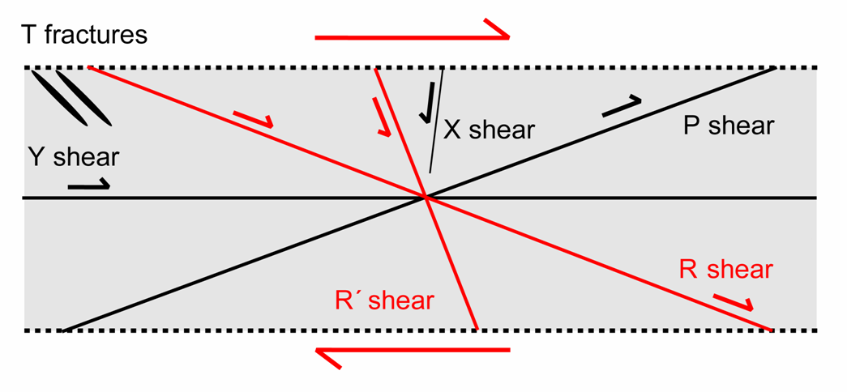
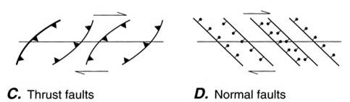
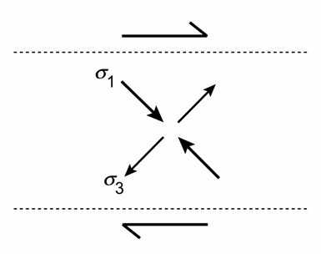
Associated fractures 2
Other important secondary fractures that are associated with strike-slip faults are:
P-shears: synthetic to the main fault
Y-shears: parallel to the main fault
T-fractures: extension fractures (tension gashes) that bisect the angle between the Riedel shears (i.e., they are parallel to σ₁)
In large strike-slip fault zones normal faults and reverse faults form approximately parallel to σ₁ and σ₃ respectively
The orientation of these secondary fractures provides an important indicator of slip sense
Notes:
We noted all these fractures when considering the fabrics that form in clay-bearing fault gouges (Class 4 Slide 45)
Figures top and bottom by Steve Covey-Crump
Figure middle by Twiss & Moores, p.138

Slide 23
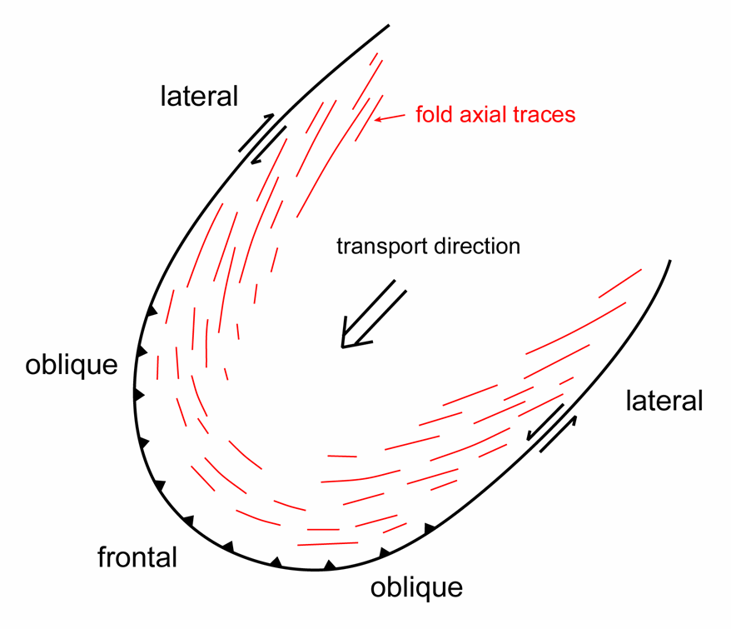
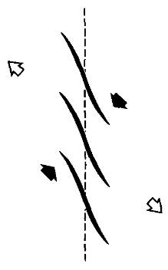
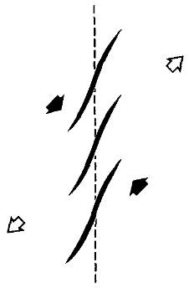
Associated folding
Folds may develop in cover rocks in response to strike-slip movement in the basement. These can be simulated by performing a strike-slip shear movement with your two hands on a sheet of fabric – folds form with hinges normal to the incremental shortening direction and the hinges rotate as shear strain increases
Note the orientation of the fold traces on the two lateral ramps of this thrust sheet
Notes:
Central figure redrawn by Steve Covey-Crump from an original in Fischer & Coward, 1982, Tectonophysics 88: 291-312, https://doi.org/10.1016/0040-1951(82)90241-4
Side figures from Sylvester, p.1680

Slide 24
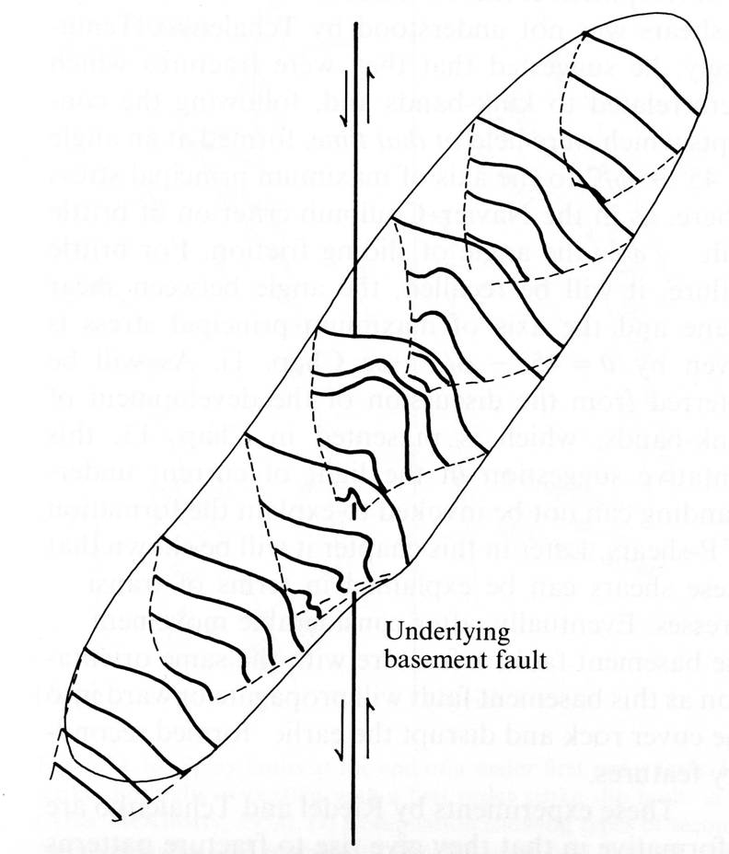

Associated folding 2
Analogue experiments with clay show that an en échelon array of simple folds forms early in the shearing and that these may later become dissected by Riedel shears
Early
Later
Analogue experiments with layers of wax show that the folds may vary from simple, gentle structures at their ends to more complex asymmetric shapes (verging towards the fault) as the line of the basement fault is approached, and that there is a reversal in symmetry as it is crossed
Notes:
Figure left from Sylvester, p.1681
Figure right from Price & Cosgrove, p.146. Price & Cosgrove, p.146, describe wax experiments designed to investigate the geometry of folds in cover units over a basement strike-slip fault

Slide 25

Fault bends and stepovers
Although strike-slip faults are characteristically straight, they do contain bends (curved parts of a continuous fault trace connecting two parallel segments) and stepovers (overlapping en échelon fault segments)
A bend or stepover is restraining if the rocks at the bend/stepover are compressed during slip on the fault, and releasing if they are pulled apart
At bends and stepovers (and indeed along any broad curve in a strike-slip fault) the displacement on the fault cannot be purely strike-slip – in these regions additional processes are required to accommodate the deformation
Notes:
Releasing stepovers and restraining stepovers are more commonly described as extensional transfer zones and contractional transfer zones, respectively (see Class 7, Slide 42)
Figure by Steve Covey-Crump

Slide 26

Releasing bends/stepovers
Slip at releasing bends and stepovers leads to extension fractures and, at larger scale, normal faults that may be arranged in map view as an extensional duplex
The normal faults in such structures generate pull-apart basins that are commonly rhomb-shaped, and can be up to 10s km across
In vertical section extensional duplexes widen towards the surface to create a flower structure. Extensional duplexes produce negative flower structures in which the component faults tend to be listric and the central part is structurally lowered
Notes:
Figure from Twiss & Moores, p.140

Slide 27



Releasing bends/stepovers 2
Small scale extensional duplex in a releasing stepover (veins in the contact aureole of the Ballachulish intrusion at Kentallen Pier)
Death Valley, California, was the first pull-apart basin to be recognized as such. It lies on a releasing bend
An extensional duplex developing on the Dasht-E Bayaz fault, NE Iran
Notes:
Photo top right by Steve Covey-Crump
Figure left from Fossen, p.409
Figure bottom right from Twiss & Moores, p.144

Slide 28



Releasing bends/stepovers 3
Analogue models of releasing bends show that in comparison with simple shear strike-slip faults, the pull-apart basins formed under overall transtension are wider, develop a set of oblique en échelon extension faults in the basin margin, and form multiple (not one) depocentres
Simple shear
Transtension
Notes:
State of the art sandbox models of the structures that form in releasing bends are described by Wu et al., 2009, Marine and Petroleum Geology 26: 1608-1623, https://doi.org/10.1016/j.marpetgeo.2008.06.007. The figures on this slide come from that paper
The figure top right shows a plan view of the experimental set up (rigid base-plates); the base-plates are covered with a thin rubber sheet, and sand is placed on top of this. The development of the structures in the sand is monitored as the base-plates are pulled apart. For transtension (the case illustrated in the figure top right), the direction in which the base plates are pulled apart is oblique to the main surface separating the plates (in the figure top right it is at 5°) so that this surface widens during slip. For the pure strike-slip case, base-plates are used in which the main surface separating the plates is parallel to the pulling direction

Slide 29


Releasing bends/stepovers 4
The analogue models successfully simulate the observed pattern of deformation in the Dead Sea pull-apart system, which changes from simple shear (Dead Sea Basin) to transtension (Gulf of Elat) southwards
Notes:
Figure left from Christiansen & Hamblin, 2007, Exploring the Planets (2nd edition), Chapter 8 (www.explanet.info/Chapter08.htm). Extracts from this book are available on-line (www.explanet.info), and provide an introductory account of “global tectonics” type matters for all the main planetary bodies within the Solar System
Figure right from Wu et al., 2009, Marine and Petroleum Geology 26: 1608-1623, https://doi.org/10.1016/j.marpetgeo.2008.06.007

Slide 30

Restraining bends/stepovers
Slip at restraining bends and stepovers leads to contractional structures (stylolites, cleavages, folds, reverse faults) and sometimes contractional duplexes
The reverse faults in such structures generate areas of topographic elevation
In vertical section, contractional duplexes, like extensional duplexes, widen towards the surface to create a flower structure. Contractional duplexes produce positive flower structures in which the component faults tend to be antilistric and the central part is structurally raised as a pop-up structure
Notes:
Figure from Twiss & Moores, p.141

Slide 31


Restraining bends/stepovers 2
Digital elevation model looking NW; the San Andreas Fault is the prominent scar separating the San Gabriel Mts (left) from the low relief Mojave Desert (right)
A well studied example of a restraining bend is the Big Bend, a ~120 km swing in orientation of the San Andreas Fault where it is intersected by the Garlock Fault in southern California
Here the compression is manifested as slip on E-W oriented thrust faults, and this has led to rapid uplift of the Transverse Ranges
Notes:
Figure top (from photojournal.jpl.nasa.gov/catalog/pia03376): DEM (Digital Elevation Model) of southern California produced from the NASA Shuttle Radar Topography Mission (SRTM), image PIA03376. The red star marks Los Angeles
Figure bottom from Sylvester, p.1675. The red star marks Los Angeles

Slide 32



Restraining bends/stepovers 3
Analogue models have succeeded in generating pop-up structures in contractional duplexes
Notes:
Figures from McClay & Bonora, 2001, American Association of Petroleum Geologists Bulletin 85: 233-260, https://doi.org/10.1306/8626C7AD-173B-11D7-8645000102C1865D. This paper provides details of some splendid sandbox models of deformation at restraining bends

Slide 33




Restraining bends/stepovers 4
Releasing and restraining bends on the Agenor Linea strike-slip system, Europa, and (right) a restraining bend on Mercury
(a) Initiation of dextral strike-slip movement
(b) Curved fault surface leads to formation of releasing and restraining bends and duplexing
(c), (d) Northward migration and straightening of faults
Notes:
Photo top left (from http://photojournal.jpl.nasa.gov/catalog/PIA01646): Galileo spacecraft image of part of the western branch of Agenor Linea on Europa (from image mosaic 17ESAGENOR03)
Figures bottom left and bottom middle (from Prockter et al., 2000, Journal of Geophysical Research 105: 9483-9488, https://doi.org/10.1029/1999JE001226): interpretations of the photo top left
Photo top right (from Massironi et al., 2012, 43rd Lunar and Planetary Science Conference abstract 1924, www.lpi.usra.edu/meetings/lpsc2012/pdf/1924.pdf): restraining bend with pop-up structure, Blossom Rupes thrust system, Mercury. This system is discussed, together with many other strike-slip features on Mercury, by Massironi et al., 2015, Geological Society, London, Special Publications 401: 269-290, https://doi.org/10.1144/SP401.16

Slide 34


Transcurrent fault terminations
Strike-slip faults may terminate in an imbricate fan of either normal faults or reverse faults depending upon the location of the zone of deformation relative to the fault slip vector
The Quetta-Charman sinistral strike-slip fault system in Pakistan terminates as an imbricate fan of thrusts that are part of a convergent margin
Notes:
Figures left and middle from Twiss & Moores, p.146
Figure right from Twiss & Moores, p.147

Slide 35



Transcurrent fault terminations 2
Extensional imbricate fan
Alternatively, the faults may terminate as a splay of small strike-slip faults – the displacement on any individual splay fault is small but the sum equals the main fault displacement
New Zealand
Notes:
Figure top left (from http://www.appstate.edu/~marshallst/research/Europa.html) showing the Agenor Linea dextral strike-slip fault system on Europa
Figure top right (from Kattenhorn & Marshall, 2006, Journal of Structural Geology 28: 2204-2221, https://doi.org/10.1016/j.jsg.2005.11.010): interpretation of the extensional imbricate fan at the eastern end of Agenor Linea. This has horsetail geometry (see Class 6 Slide 22). The numbers on the figure give the order in which each fault formed as inferred from cross-cutting relationships. For another example of a strike-slip fault system that terminates as an imbricate fan of normal faults, see the Enceladus image, bottom left Slide 16
Figure bottom (from Freund, 1974, Tectonophysics 21: 93-134, https://doi.org/10.1016/0040-1951(74)90064-X): splay of strike-slip faults associated with movement on the Alpine Fault system, New Zealand

Slide 36
Strain in strike-slip fault zones

Slide 37


Pure strike-slip and the strain ellipsoid
An understanding of strain in strike-slip fault zones is needed to establish why foliations and lineations in their fault rocks are oriented as they are, and this allows inferences to be made about the movement history + amount of transpression/transtension ± stretching
Recall the X, Y, Z nomenclature for the axes of the strain ellipsoid: usually the foliation is the XY plane and any stretching lineation is the X direction
For a vertical strike-slip fault deforming in simple shear (no transpression or transtension) we expect the foliation (XY plane) to be vertical and oblique to the margins of the fault zone, and the stretching lineation (X) to be horizontal
Notes:
Note that the foliation is approximately in the orientation of P-shears (see Slide 22). For a vertical strike-slip fault imagine turning the figure of the shear zone on the left so that the shear plane is vertical. The XZ plane is then horizontal which means that X is horizontal and the XY plane is vertical
In the following two slides we compare the fabrics formed in a pure strike-slip fault zone with those in transpressional and transtensional fault zones. The complications presented by fault-parallel stretching (see Slide 17) must be independently recognized and analysed
Figure top right from Fossen, p.34
Figure left from Fossen, p.342
Figure bottom right by Steve Covey-Crump

Slide 38



Transtension, transpression and the strain ellipsoid
The shape and orientation of the strain ellipsoid is influenced by the extent of transpression or transtension
How these change with increasing strain may be modelled and illustrated on a Flinn diagram
Flinn diagram
Effect of changing the relative amount of pure shear over simple shear (high pure shear = large α ) on the shape of the strain ellipsoid shown on a Flinn diagram
Notes:
An outline of the strain analysis required to construct the Flinn diagram shown bottom left is given by Fossen, p.410-413 (divergent strike-slip = transtension; convergent strike-slip = transpression), but is more fully described by Fossen & Tikoff, 1993, Journal of Structural Geology 15: 413-422, https://doi.org/10.1016/0191-8141(93)90137-Y. Twiss & Moores, p.343-345, also offer some helpful remarks. The analysis uses the deformation gradient matrix (the matrix which connects the positions of particles in the undeformed to deformed state) – see Class 3 Slide 8. Note that you do not need to know how such an analysis is carried out but you ought to be aware that it can be should the need ever arise
The Flinn diagram is not good at showing magnitudes of strain (it is designed to shown the shape of the strain ellipsoid). However, if α remains constant during deformation (α is defined on the figure bottom right), with progressive deformation the fault rocks will follow a path along a constant α curve away from the origin. Note that prolate (cigar-shaped) strain ellipsoids are predicted in transtension, and that oblate (pancake-shaped) strain ellipsoids are predicted in transpression
Figure top right from Fossen, p.35
Figure bottom left modified from Twiss & Moores, p.345
Figure bottom right by Steve Covey-Crump. α is the angle between the shear zone boundary and the relative velocity vector so that when α = 0 we have purely strike-slip movement and when α = ±90° we have purely contraction/extension

Slide 39

Transtension, transpression and the strain ellipsoid 2
For strongly compressional transpression (right side of figure below) one expects a vertical foliation and lineation
For strongly extensional transtension (left side of figure below) one expects a horizontal foliation and lineation
For intermediate cases (middle of figure below) the foliation is vertical and the lineation horizontal but with a complex evolution in orientation as the shear strain increases
Notes:
Figure (modified from Twiss & Moores, p.345) showing the orientation of foliations and lineations in vertical strike-slip zones under different amounts of transpression and transtension (α on the x-axis is as defined on the previous slide). This is simply an alternative way of showing the results depicted on the Flinn diagram bottom left on the previous slide. The grey arrows show increasing deformation at constant α. Three strain facies for strike-slip faults are defined – here ‘facies’ is used to identify conditions where the strain ellipsoid is of particular shape and orientation. As the grey arrows cross the thick black lines the strain facies changes, e.g., for the α = -10° arrow the foliation switches from being vertical to horizontal as it crosses the thick black line (on the Flinn diagram shown bottom left on the previous slide, this crossing point is where the α = -10° line ‘bounces off the y-axis)
A discussion of the implications of this analysis is given by Tikoff & Fossen, 1999, Journal of Structural Geology 21: 1497-1512, https://doi.org/10.1016/S0191-8141(99)00085-1. Note that these findings may be generalized to shear zones of any orientation and do not apply only to vertical strike-slip faults

Slide 40


Strain partitioning within the fault zone
Once a fault or shear zone forms it tends to localize the simple shear component of the deformation leaving the surrounding volume of rock to accommodate the pure shear component (extension or contraction)
This is described as strain partitioning, and it has been invoked to explain why fold traces along part of the San Andreas Fault Zone are sub-parallel with the fault and not oblique to it
expectation
actuality
Notes:
Figures top right and bottom left from Fossen, p.413
Figure bottom right from Sylvester, p.1680

Slide 41


Strain partitioning – Carboneras Fault Zone
Fault zones in phyllosilicate-rich lithologies have additional interesting features as illustrated by the Carboneras fault zone (SE Spain)
In SE Spain NW-SE directed compression associated with the convergence of Africa and Iberia has been complicated by NE-SW directed (back-arc) extension associated with the roll-back (to the west) of an east dipping subduction zone
Strike-slip (transform) faults bound the region of extension; the Carboneras fault zone is one of the faults on the southern boundary (Trans-Alborán Shear Zone)
Notes:
The coupling of the Crevillente and Carboneras fault systems to the subduction zone allows them to be described as transform faults. In this case, the rocks between the Crevillente and Carboneras faults have extended NE-SW more than the rocks on the other sides of these faults and so these faults may be described as stretching transform faults (see Slide 17)
While the subduction zone roll-back explanation for extension within the internal Betic cordillera is currently gaining ground, other explanations have been proposed (see Gutscher et al., 2012, Tectonophysics 574-575: 72-91, https://doi.org/10.1016/j.tecto.2012.08.038; Gutscher, 2012, Eos 93: 133-135, https://doi.org/10.1029/2012EO130001). For a similar use of slab roll-back to explain the migration of extension and associated volcanism on the Tharsis bulge on Mars (Class 9 Slide 13), see Yin, 2012, Lithosphere 4: 553-593, https://doi.org/10.1130/L195.1
For details on how the NE-SW extension was actually delivered, see Williams & Platt, 2018, Journal of the Geological Society, London 175: 465-496, https://doi.org/10.1144/jgs2017-086
Figure top from Rutter et al., 2012, Journal of Structural Geology 45: 68-86, https://doi.org/10.1016/j.jsg.2012.08.009
Figure bottom from Gutscher et al., 2012, Tectonophysics 574-575: 72-91, https://doi.org/10.1016/j.tecto.2012.08.038

Slide 42



Strain partitioning – Carboneras Fault Zone 2
The Carboneras fault zone is up to 1 km wide and has accommodated perhaps ~40 km sinistral (transpressive) strike-slip movement during the Late Miocene (12-7 Ma). The units currently at the surface were deformed at a depth of 4 - 6 km
The fault zone comprises multiple anastomosing strands of phyllosilicate-rich fault gouge (high strain) bounding lenses of variably fractured protolith (less strain)
Notes:
Significant strike-slip movement on the Carboneras fault zone had ceased by 6 Ma, when emergence/uplift took over
Map and section (from Faulkner et al., 2003, Tectonophysics 367: 235-251, https://doi.org/10.1016/S0040-1951(03)00134-3) showing a small part of the Carboneras Fault Zone. The strands of fault gouge are the light blue-grey strips
Figure left is from Burbank & Anderson, 2012, Tectonic Geomorphology (2nd edition), Wiley-Blackwell, p.93

Slide 43


Strain partitioning – Carboneras Fault Zone 3
At still smaller scale
The deformation within the strongly deformed fault gouge is distributed across each strand; P-foliations, R-, and Y-shears are well represented
The deformation within the less deformed protolith between the strands is highly localized on to fractures oriented in the R- and R´-shear orientations
The contrasts in deformation style within the fault zone are highly significant for the mechanical and permeability evolution of the fault
A different part of the Carboneras Fault Zone: the 2nd-order fractures are in the P-shear orientation, and the fold axial traces are oblique to the fault zone margins in a sense consistent with sinistral slip (small angle of obliquity → transpression normal to or stretching parallel with the fault)
Notes:
Some of the mechanical and permeability implications of this internal fault zone structure are briefly entertained by Faulkner et al., 2003, Tectonophysics 367: 235-251, https://doi.org/10.1016/S0040-1951(03)00134-3. Furthering our understanding of these matters provides a good reason for mapping such fault zones
Figure from Keller et al., 1995, Journal of the Geological Society, London 152: 339-351, https://doi.org/10.1144/gsjgs.152.2.0339

Slide 44
Section balancing in strike-slip terrains

Slide 45

Section balancing
The section balancing techniques that we have been considering in contractional and extensional tectonic regimes are inappropriate for cross sections drawn across strike-slip faults because the techniques only apply for sections drawn parallel to the XZ plane which in this case is the map view
However, the horizontal component of the slip vector can be determined by balancing in the plane of the map, and this can help to establish the extent of dip-slip vs. strike-slip movement on individual faults (and regionally)
An example of map restoration in an extensional terrain (Statfjord Formation, Gullfaks Field, North Sea)
Notes:
For the method of map restoration, see Rouby et al., 1996, American Association of Petroleum Geologists Bulletin 80: 875-890, https://doi.org/10.1306/64ED88F4-1724-11D7-8645000102C1865D
The evidence for subduction on Jupiter’s moon, Europa, comes from missing areas that arise when map balancing is carried out (see Kattenhorn & Prockter, 2014, Nature Geoscience 7: 762-767, https://doi.org/10.1038/ngeo2245)
Figure from Fossen, p.449, redrawn from Rouby et al., 1996, American Association of Petroleum Geologists Bulletin 80: 875-890, https://doi.org/10.1306/64ED88F4-1724-11D7-8645000102C1865D

Slide 46
Reading
Fossen H (2016) Structural Geology (2nd edition). Cambridge University Press. [Chapter 19]
Twiss RJ, Moores EM (2007) Structural Geology (2nd edition). WH Freeman and Co. [Chapter 6 and parts of Chapter 19]
Price NJ, Cosgrove JW (1990) Analysis of Geological Structures. Cambridge University Press. [Chapter 6]
Sylvester AG (1988) Strike-slip faults. Geological Society of America Bulletin 100: 1666-1703, https://doi.org/10.1130/0016-7606(1988)100<1666:SSF>2.3.CO;2. [Very accessible review]

